Slide 1
Assignment 2
Prashant Tiwari
EPPS 6354
2/10/2026

Slide 2
1. What are the differences between relation schema, relation and instance? Give an example using the university database to illustrate
Relation Schema is the blueprint of a relation. It describes the name of the relation and the associated attributes. Example could be a student in a university. The student would be the relation, and the attributes would be things like the ID, DOB, department, credit hours etc.
Thus the relation Schema for the relation of Student would be something like – student(ID, name, dptname, totcrd)

Slide 3
A relation itself (for example Student in previous slide) is just a logical entity that encompasses the contents of the table (all students and associated attributes for example would be the table of Student information)
A relation instance is just a snapshot of the actual relation (the table data) at a point in time. As the relation constantly changes, updates and so on, the relation instance just shows you what the relation looked like at a particular point in time.
For the UTD instructors information, “Instructors” would be the relation, the schema could look something like – instructor(ID, name, deptname, salary). And a relation instance would be the list of instructors and associated attributes at the point in time when the instance was generated.

Slide 4
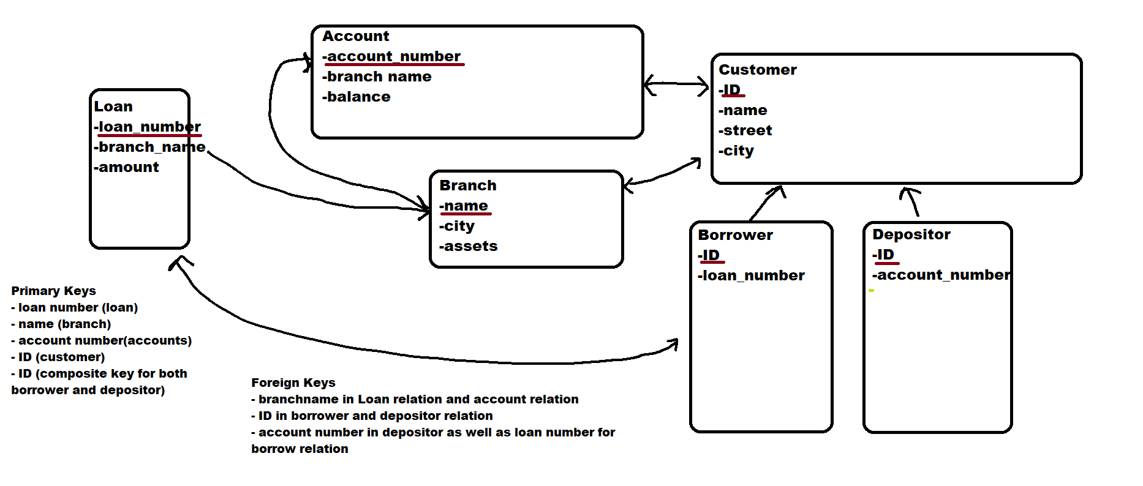

Slide 5
4. Describe two ways artificial intelligence or LLM can assist in managing or querying a database. In your answer, briefly explain how each method improves efficiency or accuracy compared to traditional (non-AI) approaches. (3–5 sentences)
1. LLMs can help users to speak directly to databases by allowing them to bypass the syntax and submit queries in the form of plain English questions. This reduces the barrier to data access. It also allows people without technical knowledge of querying languages to work with data.
2. Allows for anomaly detection that humans cannot do – can allow for early detection of fraud, data entry errors, as well as identify, consolidate and present relevant patterns or trends in data.

